Slide 1
Simple physics
Speed, acceleration, and collision
Notes:
Basic physics principles can improve your work.

Slide 2
Examples of physics in basic 2D games?
Speed, acceleration, and collision
Notes:
Basic physics principles can improve your work.

Slide 4
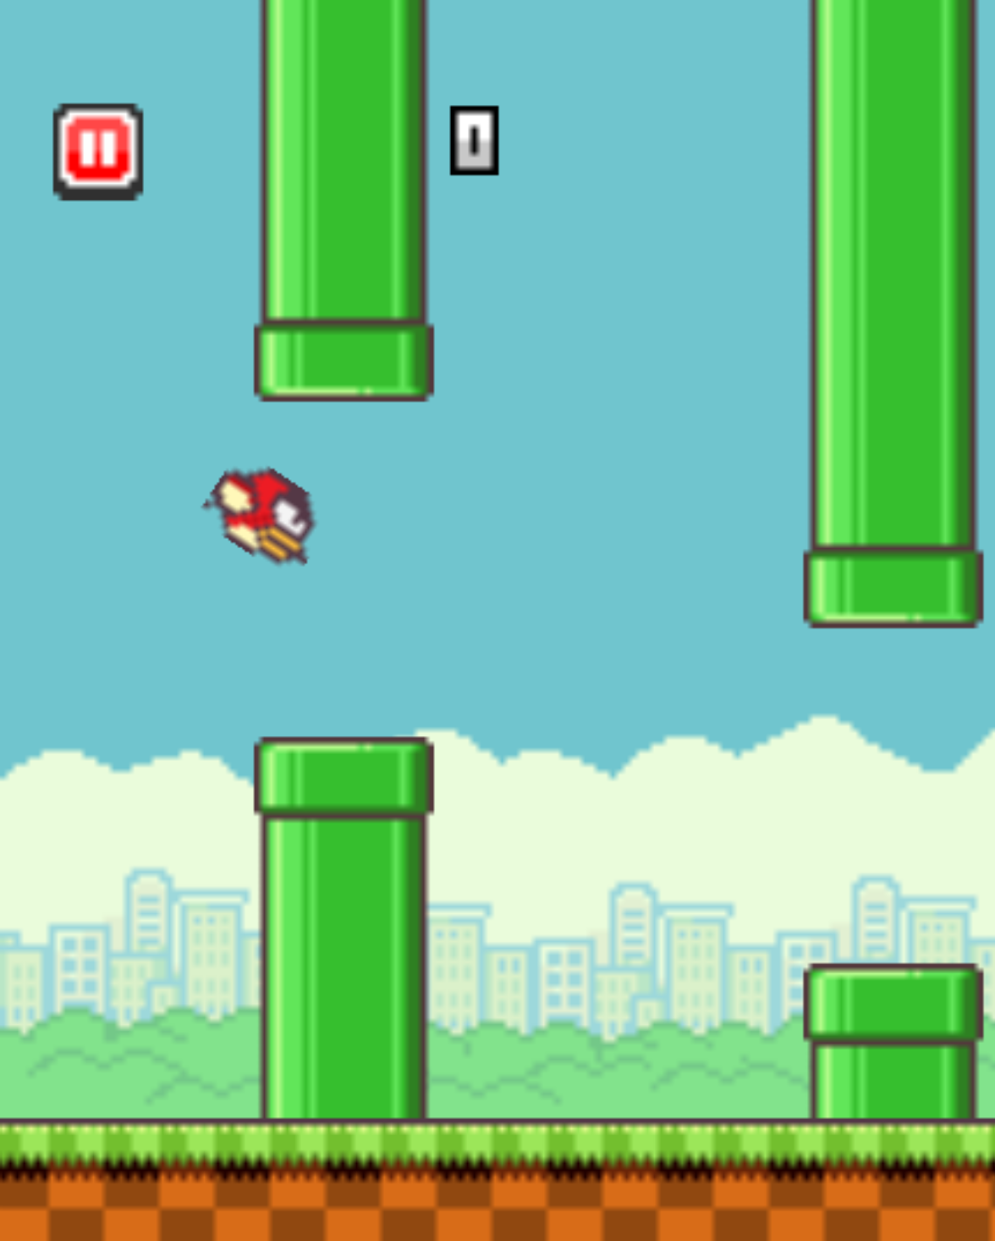
FlapMMO
Notes:
...games...

Slide 5
Distance
Notes:
Going back to day_08_08_collision, there's a basic behaviour going on here. The letters 'repel' each other. To do so, they need to know how far they are from each other.

Slide 6
Distance
dist(x1, y1, x2, y2);
// How far is this point from the mouse?
dist(x, y, mouseX, mouseY);
Notes:
Processing has a built-in function to calculate the distance between 2 points. Let's use that to create add a simple rollover behaviour to our letter. If the mouse is hovering over it, its color will change to a lighter one.
day_08_02_distance

Slide 7
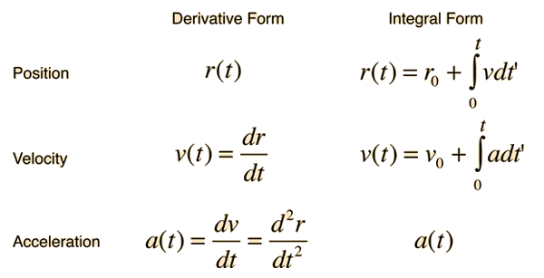
Calculus
Notes:
Now for the physics part. These are equations to describe what we're going after.

Slide 8
Calculus
(Don't worry, you don't need to know this)
Notes:
But we don't really need to use any of this. We're gonna do very simple physics.

Slide 9
Speed: a change in the position of an object over time
— this object is moving at the same speed, that is, in a constant velocity

Slide 10
POSITION = POSITION + SPEED
This is how "objects" on our screen "move."

Slide 11
Acceleration: a change in the speed of an object over time
http://gifselections.tumblr.com/post/87798725173
— gravity is the most common example of that

Slide 12
position = position + speed speed = speed + gravity
Notes:
Let's try it now! day_08_03_gravity
// Should start by just adding regular speed. Than adding gravity (acceleration)
// From that on, keep adding functions to the letters:
// Respond to mouse direction: day_08_04_direction
// Bounce: day_08_05_bouncing
//Then create the "particle system" (with arrays): day_08_06_array
// Add the collision with boundaries day_08_07_boundaries
Now to the next slide!

Slide 13
Collisions Circles
x2, y2
r
r
r
r
x1, y1
Two circles collide when the distance between their centers is less than the combined radii
Notes:
To detect the collision between the letters, we'll use the same function we had to detect mouse collision. Attention to the radii detail, though!

Slide 14
Collisions Circles
dist() calculates the distance between two points
float distance = dist(x1, y1, x2, y2);
if (distance < 2 * r) {
// we have a collision!
}
r
r
Notes:
//collision with each other: day_08_08_collision

Slide 15


Slide 16
Homework
Game Exercise 2 (10 points)
Make a one-button game for cats.
Extra credit: use arrays to create at least 10 soccer balls
Take a look at the work of Mike Tucker for simple physics simulations
For physics applied to game mechanics, check out Game Mechanic Explorer
Notes:
See work of Casey Reas.
(Note: point is to create a complex pattern computationally).
Introduce save function, too. See here: http://processing.org/reference/save_.html

